Slide 1

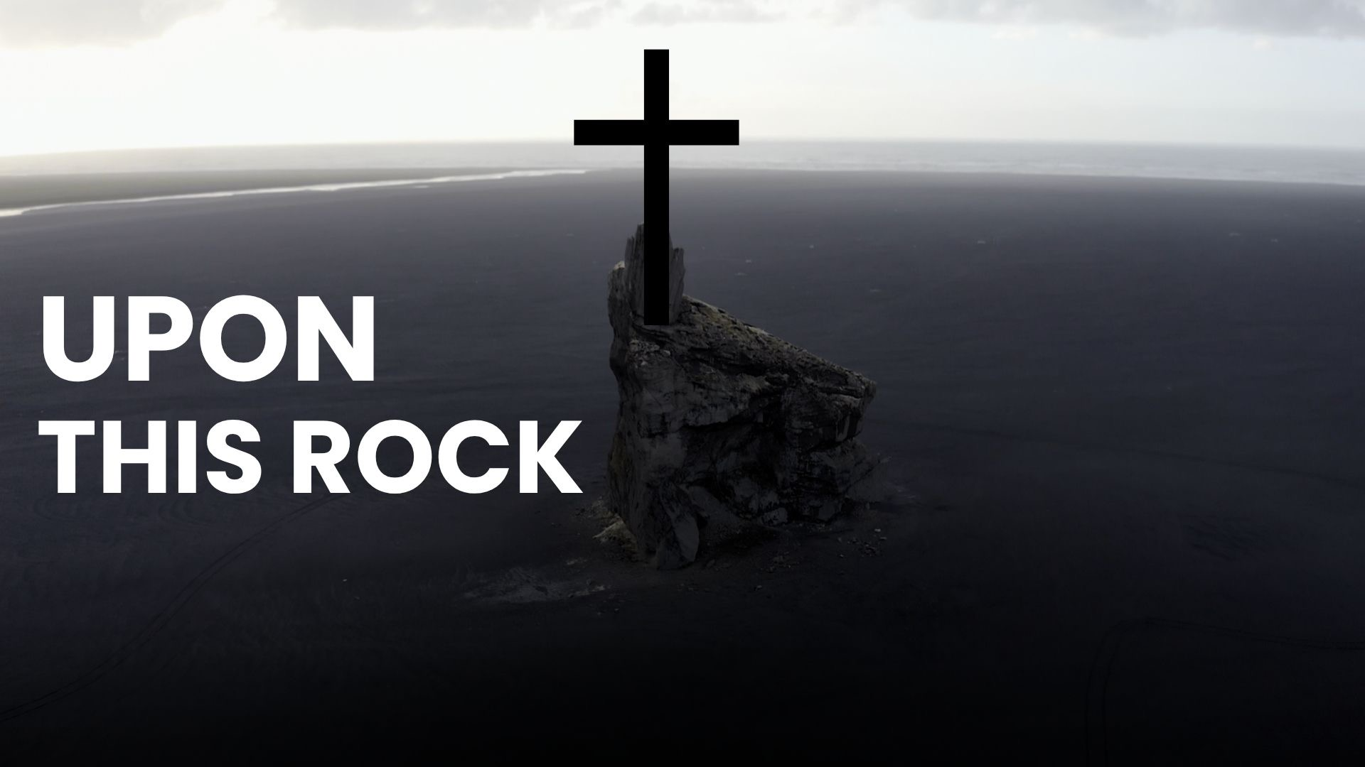
Upon This Rock (Core Values)

Slide 2
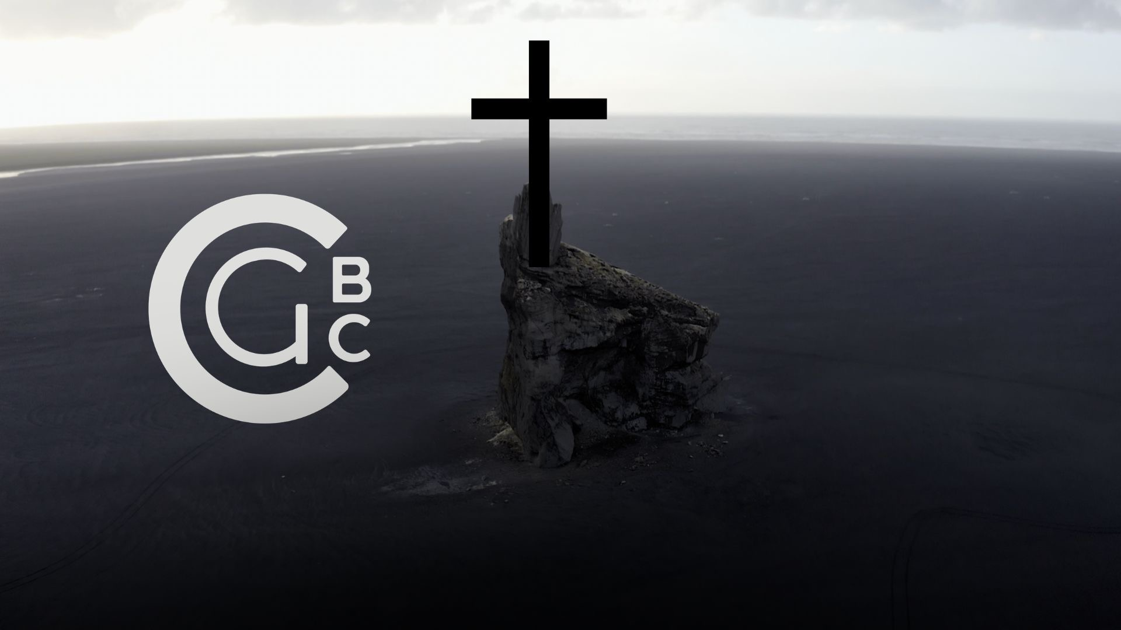

Slide 3
Cedar Grove Baptist Church exists to create a space where people and families can meet Jesus, find community, and grow in their faith.

Slide 4
Our purpose is to love others unconditionally, learn about God increasingly, live to share Jesus intentionally and lead others to Christ continually in Lebanon, TN and throughout the whole world.

Slide 5
15 He said to them, “But who do you say that I am?” 16 Simon Peter answered, “You are the Christ, the Son of the living God.”
Matthew 16:15–19
NASB95

Slide 6
17 And Jesus said to him, “Blessed are you, Simon Barjona, because flesh and blood did not reveal this to you, but My Father who is in heaven. 18 “I also say to you that you are Peter, and upon this rock I will build My church; and the gates of Hades will not overpower it.
Matthew 16:15–19
NASB95

Slide 8
19 “I will give you the keys of the kingdom of heaven; and whatever you bind on earth shall have been bound in heaven, and whatever you loose on earth shall have been loosed in heaven.”
Matthew 16:15–19
NASB95

Slide 9
I will uphold the sanctity of the family

Slide 10
I will live daily with integrity in thought, word, and deed.

Slide 11
In the Old Testament, the Hebrew word translated “integrity” means “the condition of being without blemish, completeness, perfection, sincerity, soundness, uprightness, wholeness.” Integrity in the New Testament means “honesty and adherence to a pattern of good works.”

Slide 12
Relationships

Slide 14
I will build and grow each of the four relationships represented in the purpose statement of my church.

Slide 15
By seeking to love others unconditionally

Slide 16
12 “This is My commandment, that you love one another, just as I have loved you. 13 “Greater love has no one than this, that one lay down his life for his friends.
John 15:12–13
NASB95

Slide 17
8 But God demonstrates His own love toward us, in that while we were yet sinners, Christ died for us.
Romans 5:8
NASB95

Slide 18
ἁμαρτωλός (hamartōlos). adj. sinful. It denotes sinful behavior.
Lexham Theological Wordbook

Slide 19
1 And you were dead in your trespasses and sins, 2 in which you formerly walked according to the course of this world, according to the prince of the power of the air, of the spirit that is now working in the sons of disobedience.
Ephesians 2:1–5
NASB95

Slide 20
3 Among them we too all formerly lived in the lusts of our flesh, indulging the desires of the flesh and of the mind, and were by nature children of wrath, even as the rest. 4 But God, being rich in mercy, because of His great love with which He loved us,
Ephesians 2:1–5
NASB95

Slide 22
5 even when we were dead in our transgressions, made us alive together with Christ (by grace you have been saved),…
Ephesians 2:1–5
NASB95

Slide 23
4 Love is patient, love is kind and is not jealous; love does not brag and is not arrogant, 5 does not act unbecomingly; it does not seek its own, is not provoked, does not take into account a wrong suffered,
1 Corinthians 13:4–7
NASB95

Slide 24
6 does not rejoice in unrighteousness, but rejoices with the truth; 7 bears all things, believes all things, hopes all things, endures all things.
1 Corinthians 13:4–7
NASB95

Slide 25
By growing in our faith through learning about God increasingly

Slide 26
4 Make me know Your ways, O Lord; Teach me Your paths. 5 Lead me in Your truth and teach me, For You are the God of my salvation; For You I wait all the day.
Psalm 25:4–5
NASB95

Slide 27
By building up the church though living to share Jesus intentionally

Slide 28
14 Afterward He appeared to the eleven themselves as they were reclining at the table; and He reproached them for their unbelief and hardness of heart, because they had not believed those who had seen Him after He had risen.
Mark 16:14–15
NASB95

Slide 29
15 And He said to them, “Go into all the world and preach the gospel to all creation.
Mark 16:14–15
NASB95

Slide 30
κήρυσσω (kēryssō). vb. to preach or proclaim. Refers to publicly preaching or proclaiming a message.
Lexham Theological Wordbook

Slide 31
By expanding the kingdom of God though leading others to Christ continually

Slide 33
18 And Jesus came up and spoke to them, saying, “All authority has been given to Me in heaven and on earth. 19 “Go therefore and make disciples of all the nations, baptizing them in the name of the Father and the Son and the Holy Spirit,
Matthew 28:18–20
NASB95

Slide 34
20 teaching them to observe all that I commanded you; and lo, I am with you always, even to the end of the age.”
Matthew 28:18–20
NASB95

Slide 35
by loving others unconditionally, learning about God increasingly, living to share Jesus intentionally and leading others to Christ continually in Lebanon, TN and throughout the whole world.

Slide 36
13 for “Whoever will call on the name of the Lord will be saved.”
Romans 10:13–15
NASB95

Slide 37
14 How then will they call on Him in whom they have not believed? How will they believe in Him whom they have not heard? And how will they hear without a preacher?
Romans 10:13–15
NASB95

Slide 38
15 How will they preach unless they are sent? Just as it is written, “How beautiful are the feet of those who bring good news of good things!”
Romans 10:13–15
NASB95

